Slide 1
SMART PERSONAL FINANCE MANAGER
Ha Nhat Thai 22521316

Slide 2
Table of Contents
01
03
05
02
04
06
Purpose
Entity-Relationship Diagram
Oracle Connect
Problem Description
Relational Model and Diagram
Demo Program

Slide 3
01
Purpose

Slide 4
Purpose
Better understanding of personal finances: Spending management helps us grasp our personal finances, thereby making smart and purposeful decisions.
Control and reduce unnecessary expenses: Tracking daily expenses helps us recognize unnecessary expenses and thereby cut them down.
Establish and maintain a saving habit: Managing expenses not only helps us save money but also helps us build and maintain a saving habit, which is very important for sustainable financial development.

Slide 5
02
Problem Description

Slide 6
Problem Description
The personal expense management system is designed to help users record and track all transactions related to expenses and income. The system includes data tables such as User, ExpensesType, Expenses, IncomeType and Income. The User table stores user information including full name, gender, email and password. The ExpensesType and IncomeType tables define the types of expenses and income that users can record in the system. The Expenses and Income tables are used to record information about users' spending and income transactions. Each type of income or expense is only related to a single transaction but can be used in many different transactions. The system helps users track and control their personal finances effectively.

Slide 7
03
Entity-Relationship Diagram

Slide 8
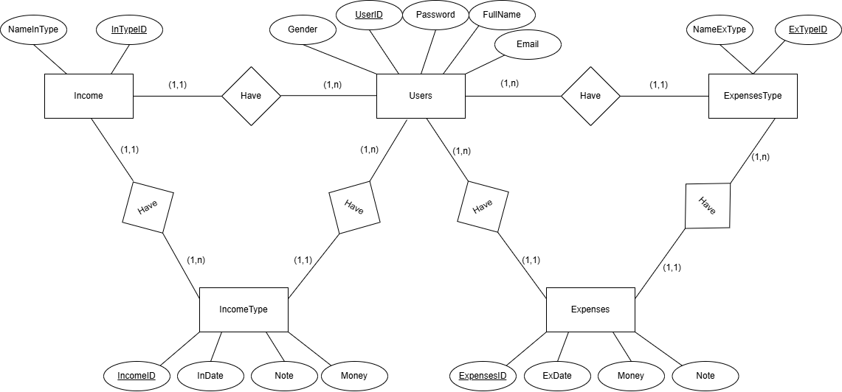
Entity-Relationship Diagram
https://drive.google.com/file/d/1IVUOjHTUvWAcQAVlNJdQavptvcLa4fAI/view?usp=sharing

Slide 9
04
Relational model and diagram

Slide 10
Relational Model
User(UserID, Fullname, Gender, Email, Password).
ExpensesType(ExTypeID, NameExType, UserID, isActive).
Expense(ExpensesID, Exdate, Money, Note, UserID, ExTypeId).
IncomeType(InTypeID, NameInType, UserID, isActive).
Income(IncomeID, Indate, Money, Note, UserID, InTypeID).

Slide 11
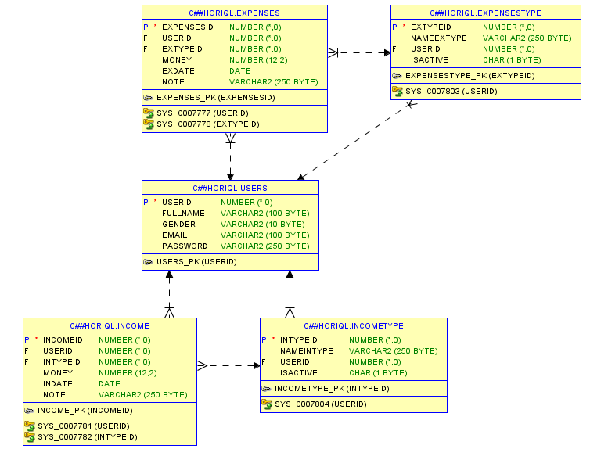
Relational Schema diagram

Slide 12
05
Oracle Connect

Slide 13
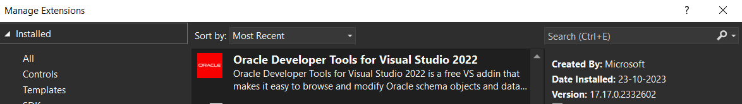
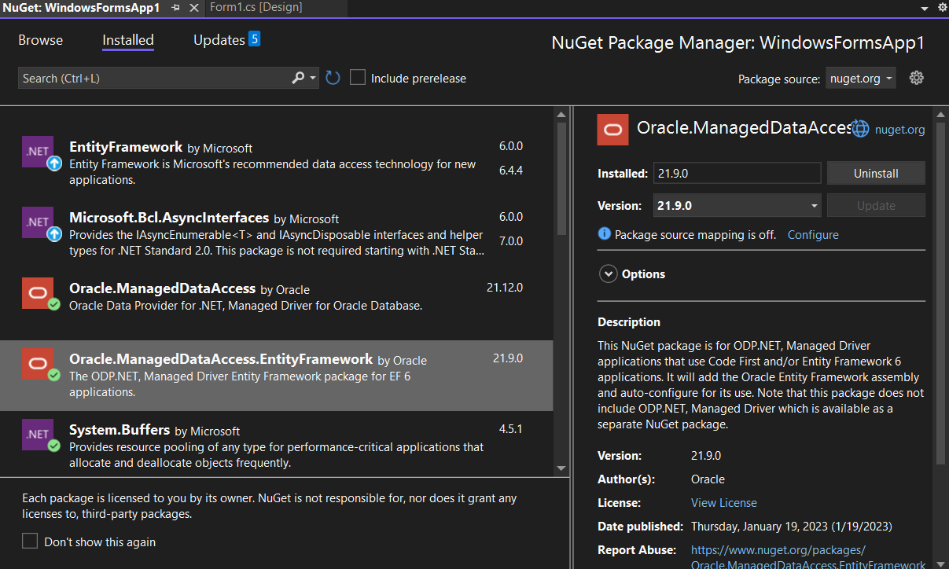
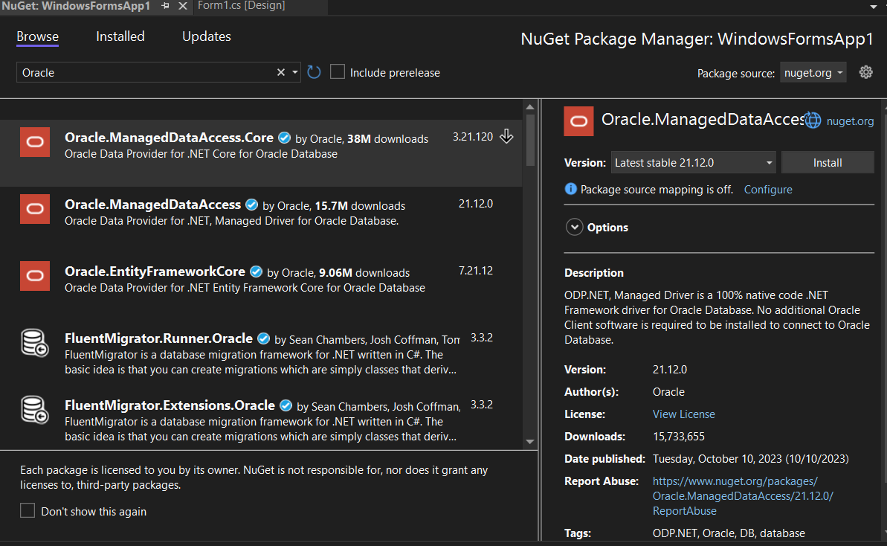
Extentions and Packet

Slide 14
06
Demo Program

Slide 15
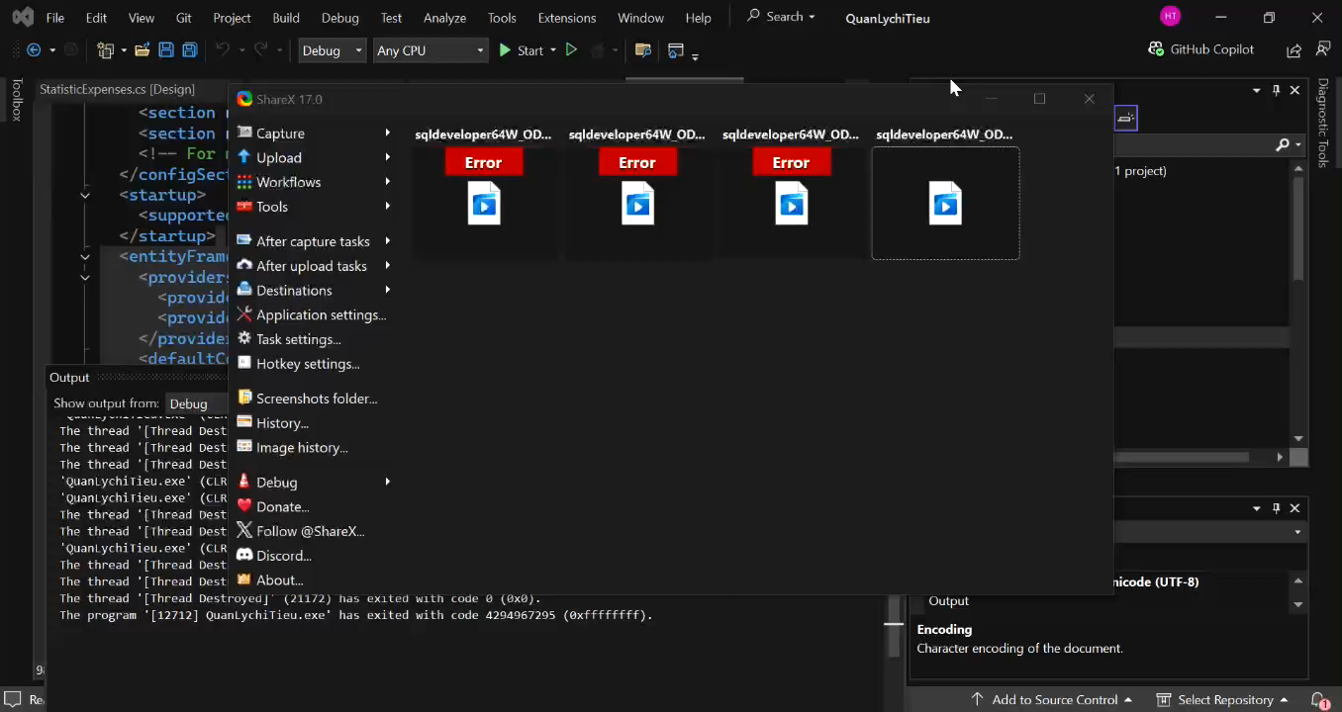

Slide 16
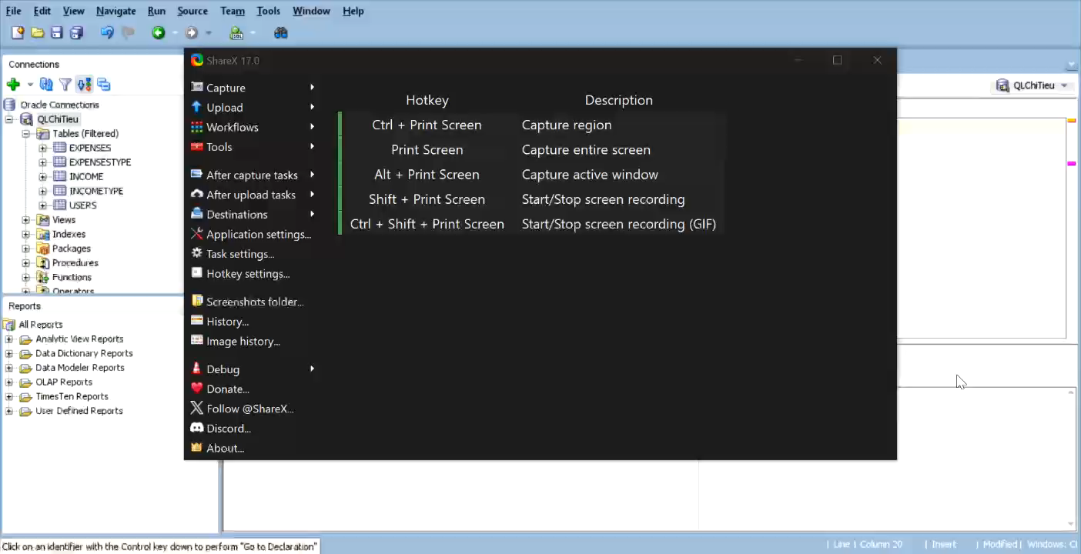

Slide 17
Thanks You Very <uch!

